Slide 1

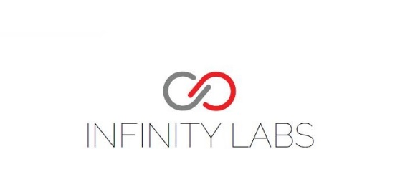
BFSI BLOCKCHAIN HACKATHON
Invoice Financing on Blockchain
IFB
(Invoice Financing Marketplace)

Slide 2

Name: Narendranath Reddy Thota
Trainer from Gamma
Blockchain Full Stack Developer
Technology Analyst Micro services
Technology Speaker
UID: U54886, MAERSK
Email: narendranath.thota@ust-global.com
https://www.developerweekend.org/
Notes:
Tell us about your team.

Slide 3



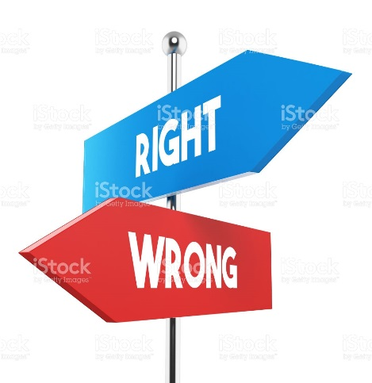







TruthChain
Truth Articles
Notes:
Quick summary capturing the value proposition of your idea. It is the unique positioning concept that sets your product apart.

Slide 4
Problem
Today Invoice Financing process is very complex and highly regulated with several participants, these participants interact with each other and exchange data and documents and adding transactions to value chain.
Each participant maintains individual copies of data and documents in different formats in varying levels of depth this leads to processing delays and higher costs Reconciliation issues and errors with limited risk transparency.
In traditional invoice factoring or discounting, invoices need to be verified before being funded. The approval process is carried out manually, requires a lot of paperwork and still does not protect a lender from Refinance and this is precisely where the benefits of block chain and smart contracts come into play.
As of now only some big finance companies are able to get invoices and doing financing.
It is a big challenge to small finance companies, normal people who has money and want to do invoice financing.
Problem
Notes:
What problem are you solving? What is new and unique about what you are doing?

Slide 5
Solution
A smart contract can include multiple parties such as, lenders, borrowers, buyers, sellers and others. Once deployed, contract (ledger) keep on updating by the different participants.
Since the contract will not allow for additional financing to be received for an invoice that has already been financed, this architecture also prevents duplicate invoice factoring.
Invoice duplication has been a significant obstacle it preventing invoice factoring solutions from being more readily available to SMEs, but the incorporation of block chain technology eliminates this issue.
Solution
The key advantages to using block chain for storing and tracking invoices in the invoice factoring or discounting process are as follows:
1. Full business transparency is ensured
2. Refinancing is prevented (double spend/double sell)
3. The lending process is fully automated
4. Brake down the barriers to finance invoices by giving everyone the opportunity to invest on invoices.
Notes:
What problem are you solving? What is new and unique about what you are doing?

Slide 6
Features
Entity: who creates Finance
Investor: who invest in invoice
Core Features of IFB:
Refinancing is prevented (double spend/double sell)
Identity management by Blockchain (Entity, Investor)
User credentials for create finance portal are stored in Blockchain
User credentials for Invest portal are stored in Blockchain
IFB Creates a platform where small, big, common people, every one who has identity can finance the invoices.
Brake down the barriers to entry, giving everyone the opportunity to invest
Financed Invoice Transactions are broadcasted to all investors with out reloading the page by web sockets.(Proof)
Invoice search option has been provided with the help of mongo dB to select particular invoices.
Investors can see who are all present Online with out reloading page by web sockets.
A beautiful dashboard where all invoices are present and accessible by all members.
The lending process is fully automated
IFB
Notes:
What problem are you solving? What is new and unique about what you are doing?

Slide 7
Product - IFB
Entity: who creates Finance
Investor: who invest in invoice
IDM(Identity Management
It creates identities of
Investors
Entities
Invoice Creation Portal
It creates invoices and deploy to Blockchain as contracts
Invoice Financing Portal
Finance invoice, dashboard –with search capabilities, Transactions broadcast, online investors (by web sockets)
Notes:
What problem are you solving? What is new and unique about what you are doing?

Slide 8
About - Invoice financing
Invoice financing is a general term used in asset based lending for products which allow companies to get finance for their slow-paying accounts receivable. Once a buyer receives goods, a buyer has 90–120 days to pay for them. But is there any way that the seller can get their funds faster? Well, this can be achieved by selling invoices to a factoring company in exchange for immediate payment. But why do companies need their invoices paid faster? For cash flow reasons. They need funds in order to buy materials, pay for the production of goods or even to pay their employees’ salaries. And this is precisely the gap that the IFB is looking to fill. Through IFB, an entirely new market is opened up which provides liquidity to SMEs that are not able to get invoice factoring from traditional institutions. Put simply, it’s a game changer for the industry.
Factoring is easier to get than conventional financing because you are technically selling an asset rather than getting a loan.
As of now one factoring company – normal process
Future IFB(lot of investors instead of single company) – End – to –End with Blockchain
Notes:
Quick summary capturing the value proposition of your idea. It is the unique positioning concept that sets your product apart.

Slide 9


Technology Architecture
UI
Html
Bootstrap
Proxy
Web3JS
Instead of downloading a full node will use chrome Extension(Metamask) for POC purpose
Metamask
Chrome
Extension(Metamask)
Blockchain
Notes:
Who is going to be the target market - customer demographics, purchasing habits, buying cycles, and willingness to adopt the solution? Is there a viable market? How will the product make money? What is your competitive readiness to realize unmet customer needs.

Slide 10
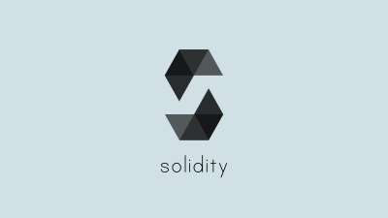
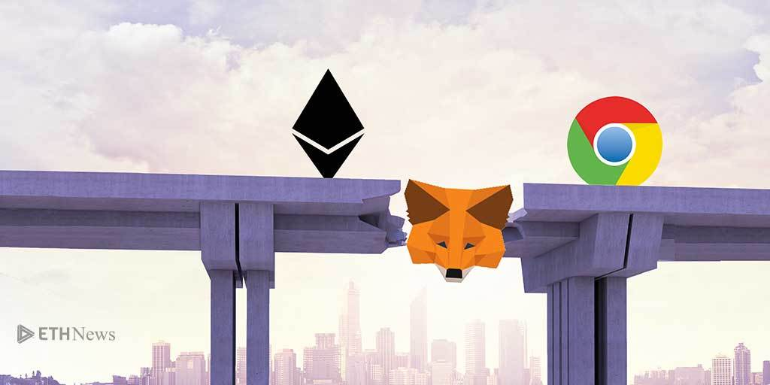


Technology Stack
JavaScript
Html, CSS
Bootstrap
Truffle(Not Mandatory)
Web3js
REST
Websockets- Socket.io
WebPack
Solidity Language-(contracts)
Ethereum (Ropston Test Network)
Metamask
Notes:
Who is going to be the target market - customer demographics, purchasing habits, buying cycles, and willingness to adopt the solution? Is there a viable market? How will the product make money? What is your competitive readiness to realize unmet customer needs.

Slide 11
Possibilities from Blockchain
Development
Enterprise app
In Memory Blockchain
Ropsten Test Network
Kovan Test Network
Rinkeby Test Network
Ethereum Main Network
IBM Hyper ledger
Cloud Blockchain as a service

Slide 12
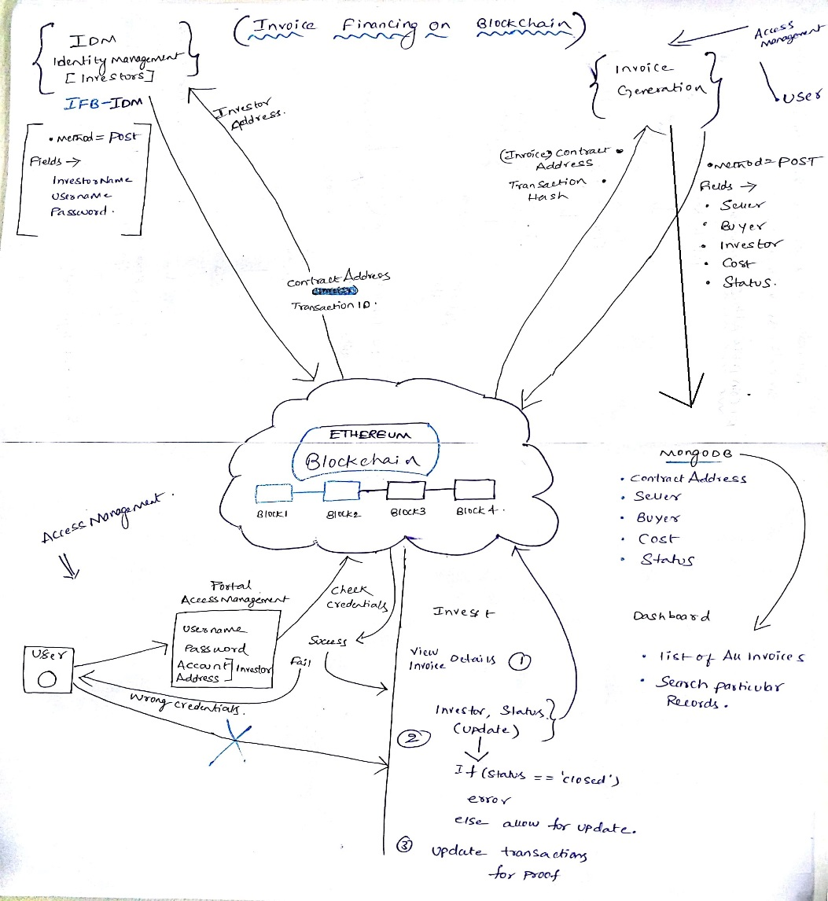
Solution Architecture

Slide 13
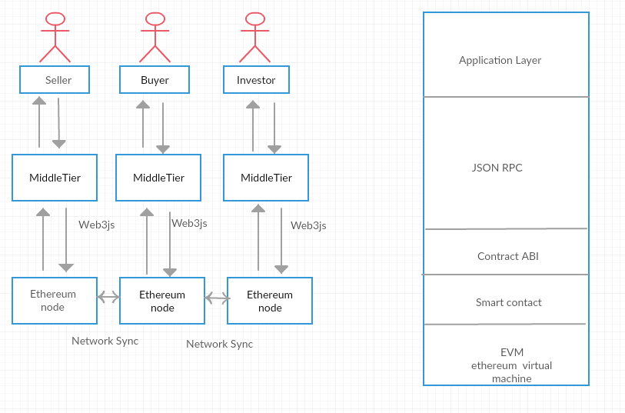
Implementation Approach
Notes:
Who is going to be the target market - customer demographics, purchasing habits, buying cycles, and willingness to adopt the solution? Is there a viable market? How will the product make money? What is your competitive readiness to realize unmet customer needs.

Slide 14
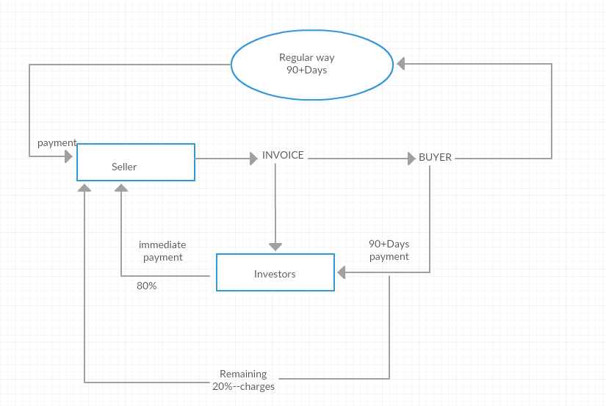
Business Model
Notes:
Who is going to be the target market - customer demographics, purchasing habits, buying cycles, and willingness to adopt the solution? Is there a viable market? How will the product make money? What is your competitive readiness to realize unmet customer needs.

Slide 15
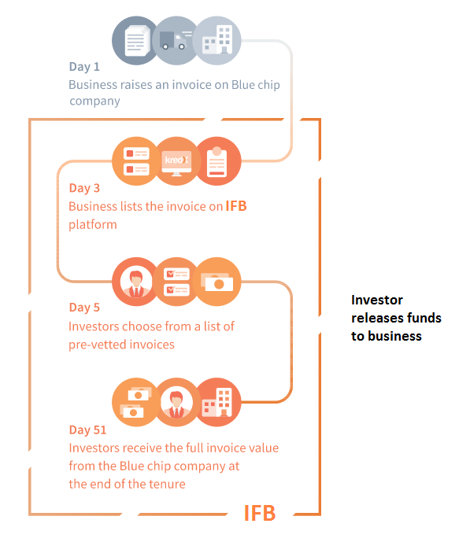
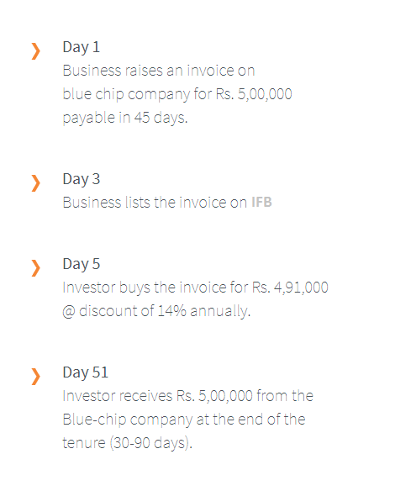
End – to – End with Blockchain

Slide 16
Differentiated Value Proposition
Low Cost:
Blockchain somehow cut the cost of doing businesses, powering processes and handling data.
Security:
Blockchain use cryptography to offer secure transaction channels, smart contracts and shared databases.
Privacy:
Blockchain afford their users privacy either by masking their real world identities or by denying access to those who are not party to a transaction.
Speed:
Blockchain add speed to transaction mostly by cutting out the middle persons and leveraging on a global network of nodes.
Open source assets
All blockchains act as virtual machine to run decentralized applications, which makes it unnecessary to buy or hire servers. Most of them are also designed to act as free to use databases.
Notes:
Who is going to be the target market - customer demographics, purchasing habits, buying cycles, and willingness to adopt the solution? Is there a viable market? How will the product make money? What is your competitive readiness to realize unmet customer needs.

Slide 17
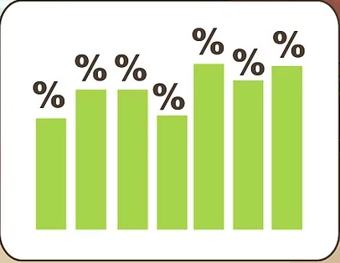
Target Market
Entrepreneurs, small and medium size businesses try very hard at the start to make their businesses work, they sometimes jump or find themselves in these type of sales arrangements in order to complete sales of their products. The payment terms may not always be favorable to them but that’s business and they need to sell their goods or services to keep the business from going under. This sometimes causes what is known as a cash flow problem if the seller of the goods or services needs the money sooner to pay other things like wages, suppliers or other types of business expenses.
Finally targeting entrepreneurs, common people as investors for Invoice Financing (starting from 10,000)
Notes:
Who is going to be the target market - customer demographics, purchasing habits, buying cycles, and willingness to adopt the solution? Is there a viable market? How will the product make money? What is your competitive readiness to realize unmet customer needs.

Slide 18
DEMO

Slide 19
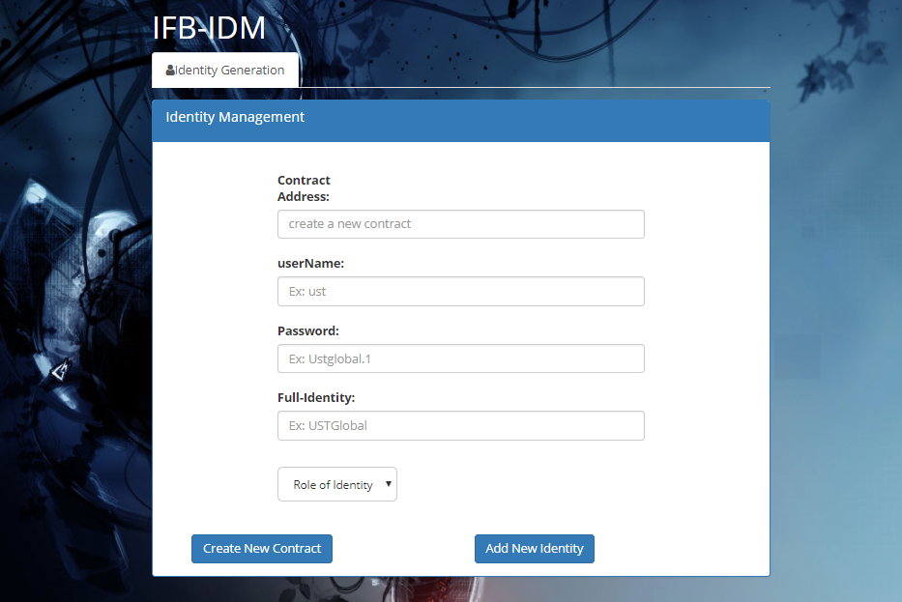

Slide 20
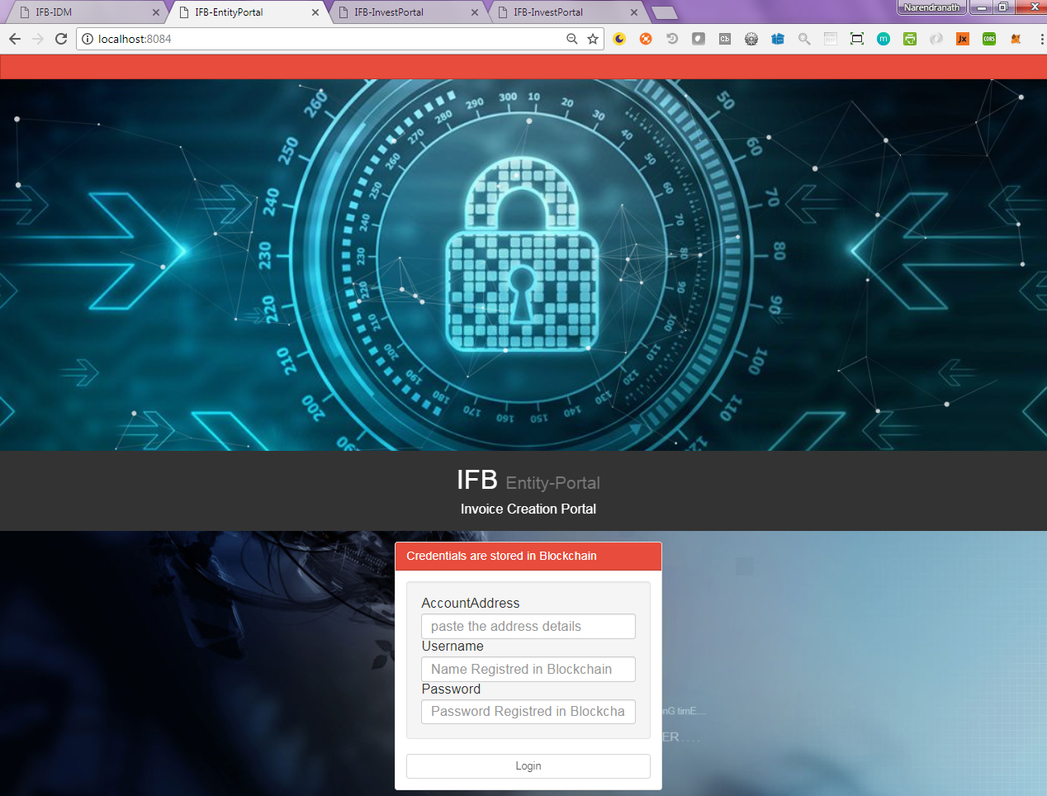
Notes:
Tell us about your team.

Slide 21
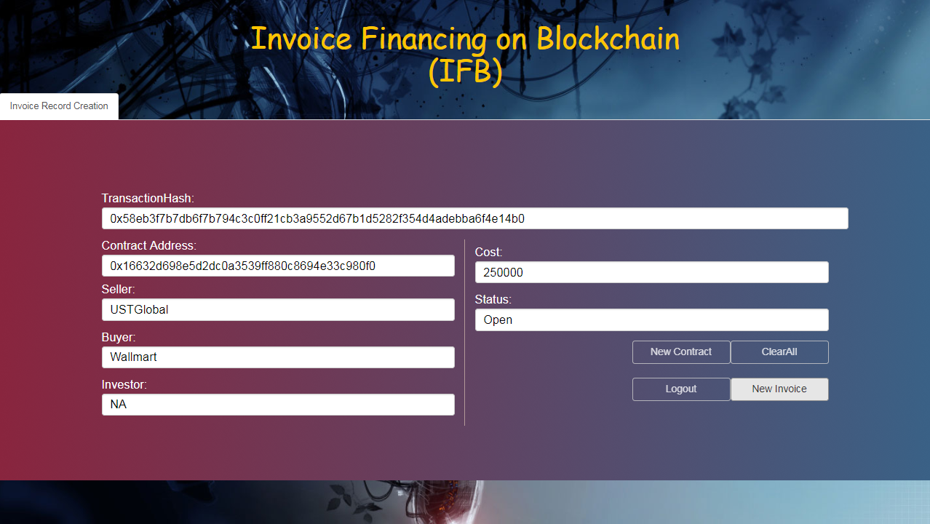

Slide 22
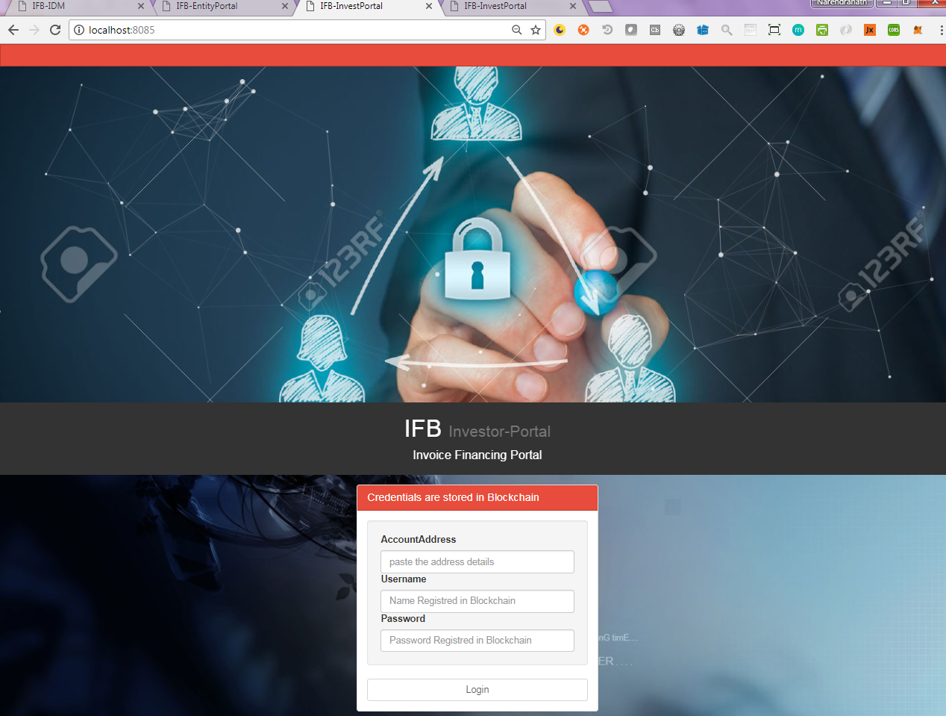

Slide 23
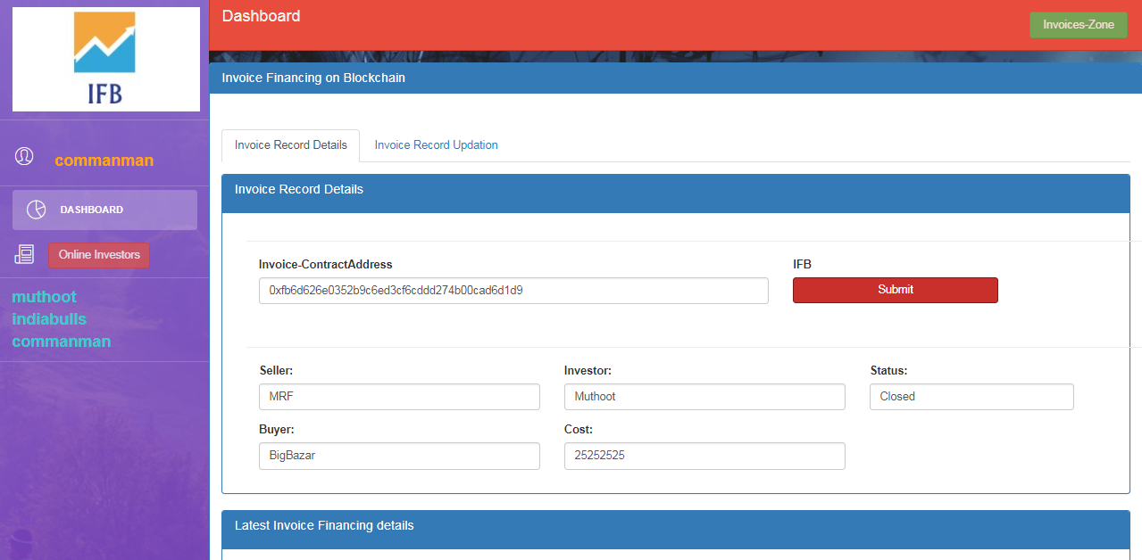
Notes:
Tell us about your team.

Slide 24
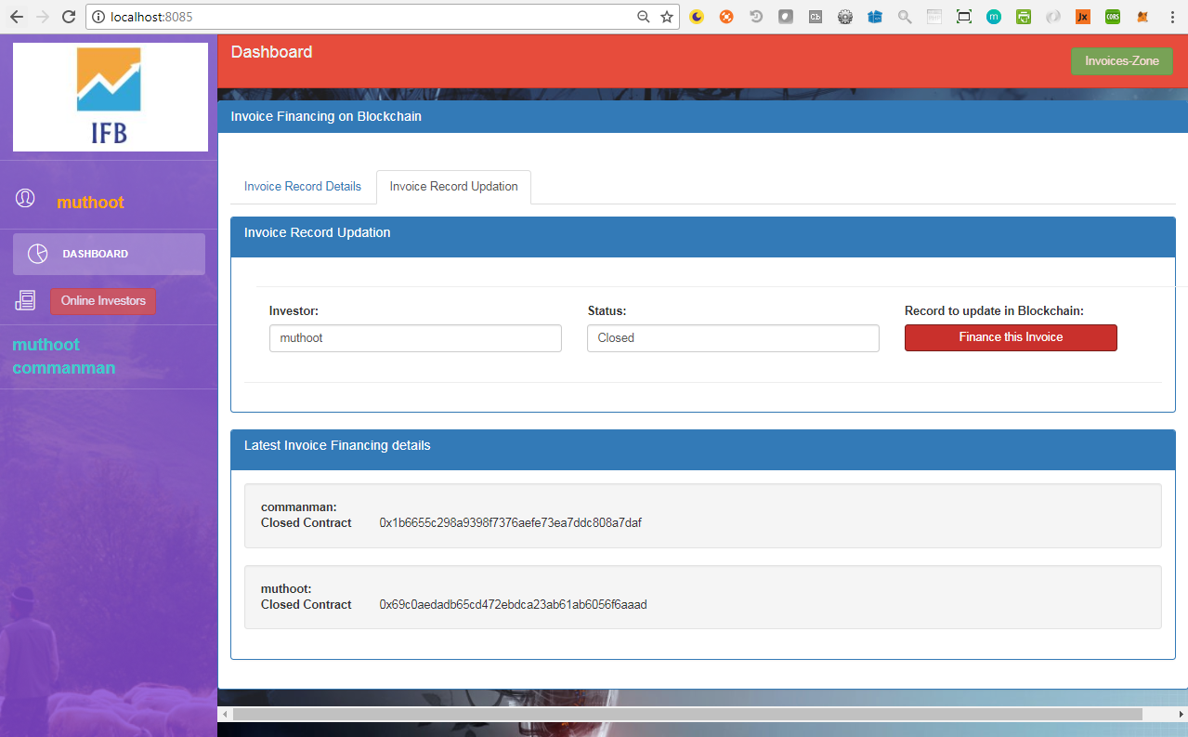

Slide 25
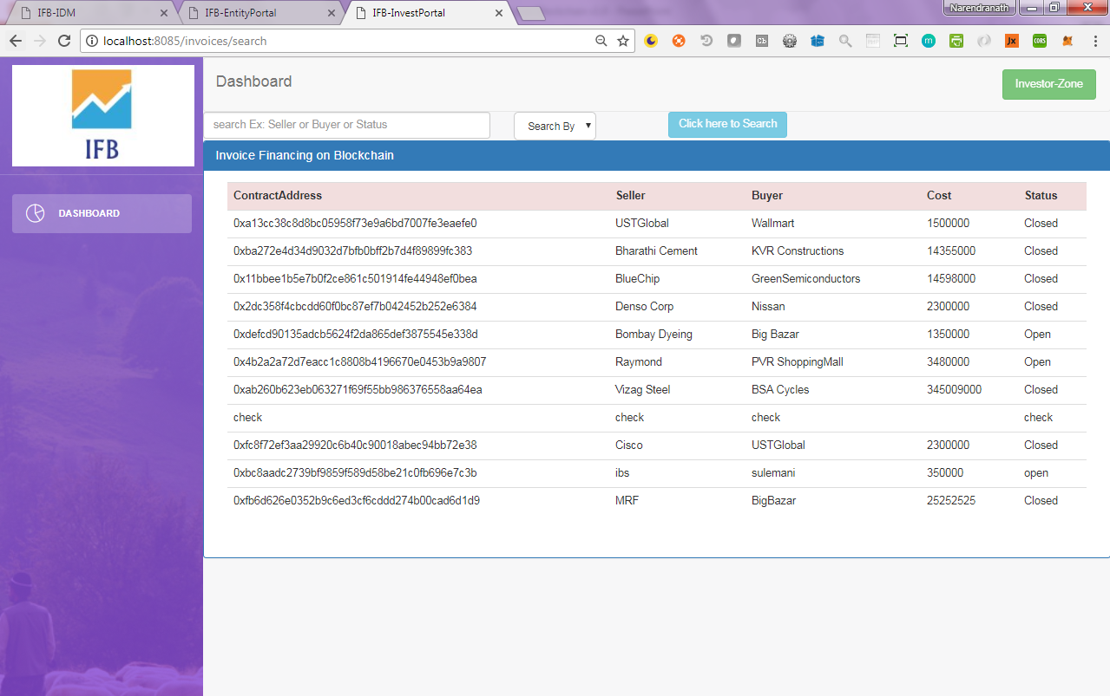

Slide 26
Future Functionalities
JWT for authentication ( storing tokens in session)
Replace Mongo dB with IPFS
Maintain a consortium Blockchain for IFB

Slide 27
ROI
Show ROI for UST and for customer
Did you know that the invoice finance industry is self-regulated
This means that anyone can lend money to businesses and you do not need a license to do that. I’ve often wondered in the past why this industry is dominated by banks and financial institutions and not by the people. The simple answer is capital. But that is all about to change with the arrival of IFB. I’m aiming to brake down the barriers to entry, giving everyone the opportunity to invest from as little as 10,000 and earn interest investors could only dream of.. A financial revolution is coming.
Notes:
What is UST’s ROI?
What is the potential customers ROI?

Slide 28
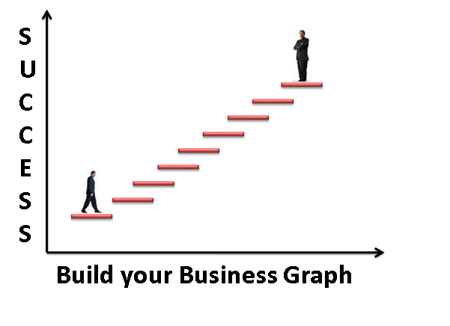
Vision and Roadmap
Vendors
Buyers
Investors
consortium
Blockchain
AI
Chabot's
Notes:
Who is providing the competitive products? How is your product uniquely positioned compared to competition?

Slide 29


ROI
Show ROI for UST and for customer
$x M?
$y M?
Notes:
What is UST’s ROI?
What is the potential customers ROI?

Slide 30
Competition
Who else has a similar product?
Innovative Idea
Competitors: No Competitors
Notes:
Who is providing the competitive products? How is your product uniquely positioned compared to competition?

Slide 31
GTM Strategy
TAM
Target is
Invoice Financing
Sector
Customer Segments
IT Industry, Banking, Finance
Product
IFB
Pricing
Depends on the Market
Profits
Service Charges
Product Packaging
Contract &
Build files
Notes:
Total addressable market (TAM) – How much is the annual revenue if you are the only provider for the solution?
Customer segment – How can you segment the customers into different groups based on common buying characteristics, needs etc.
Product – your solution.
Pricing – What is the mode / unit of pricing – is it based on perpetual model, subscription based (annual/monthly, per user, per transaction, API usage)
Sales channels – How will you sell your product - Direct sales or partner or reseller / VAR or OEM etc.
Product packaging – Different flavors of the product for different segments? Versions – basic/advanced. Is it bundled with another product?

Slide 32
THANK YOU
ADDRESS
EMAIL
PHONE
UID: U54886, MAERSK -Account
narendranath.thota@ust-global.com
7288838869

